Slide 1
Chapter 6: Functions

Slide 2
6.1
Modular Programming

Slide 3
Modular Programming
Modular programming: breaking a program up into smaller, manageable functions or modules
Function: a collection of statements to perform a task
Motivation for modular programming:
Improves maintainability of programs
Simplifies the process of writing programs

Slide 4
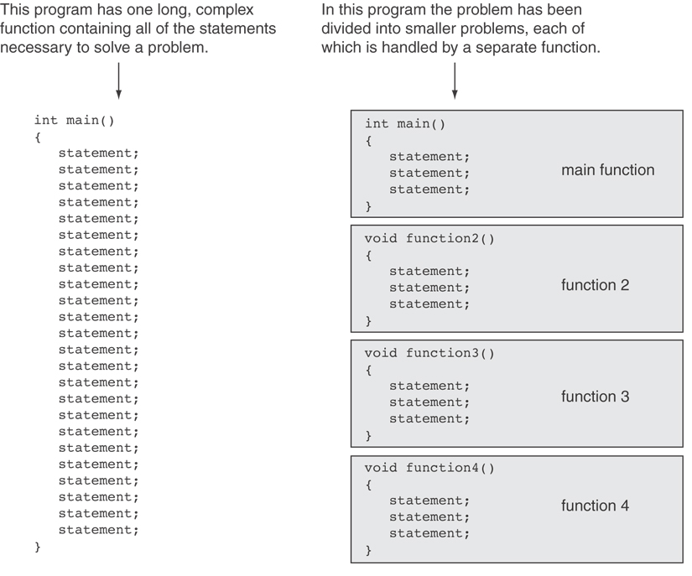

Slide 5
6.2
Defining and Calling Functions

Slide 6
Defining and Calling Functions
Function call: statement causes a function to execute
Function definition: statements that make up a function

Slide 7
Function Definition (1 of 2)
Definition includes:
return type: data type of the value that function returns to the part of the program that called it
name: name of the function. Function names follow same rules as variables
parameter list: variables containing values passed to the function
body: statements that perform the function’s task, enclosed in {}

Slide 8
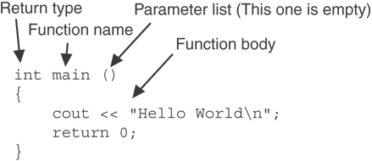
Function Definition (2 of 2)
Note: The line that reads int main()is the function header.

Slide 9
Function Return Type
If a function returns a value, the type of the value must be indicated:
int main()
If a function does not return a value, its return type is void:
void printHeading()
{
cout << "Monthly Sales\n";
}

Slide 10
Calling a Function
To call a function, use the function name followed by () and ;
printHeading();
When called, program executes the body of the called function
After the function terminates, execution resumes in the calling function at point of call.

Slide 11
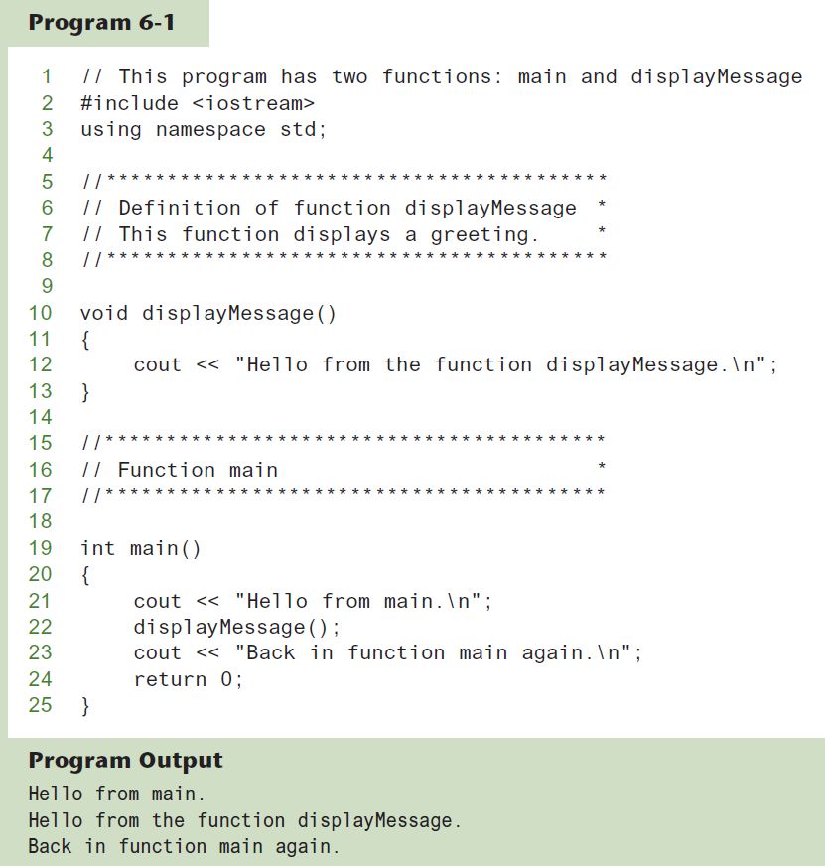
Functions in Program 6-1

Slide 12
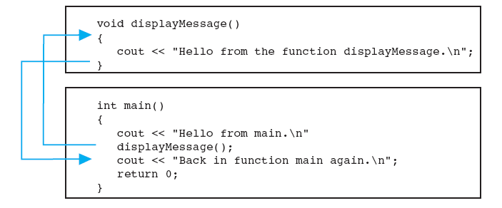
Flow of Control in Program 6-1

Slide 13
Calling Functions
main can call any number of functions
Functions can call other functions
Compiler must know the following about a function before it is called:
name
return type
number of parameters
data type of each parameter

Slide 14
6.3
Function Prototypes

Slide 15
Function Prototypes
Ways to notify the compiler about a function before a call to the function:
Place function definition before calling function’s definition
Use a function prototype (function declaration) – like the function definition without the body
Header: void printHeading()
Prototype: void printHeading();

Slide 16
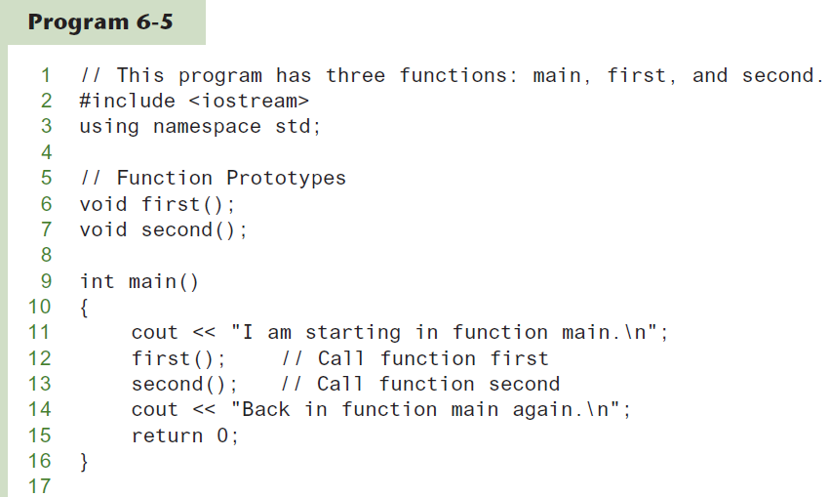
Function Prototypes in Program 6-5 (1 of 2)

Slide 17
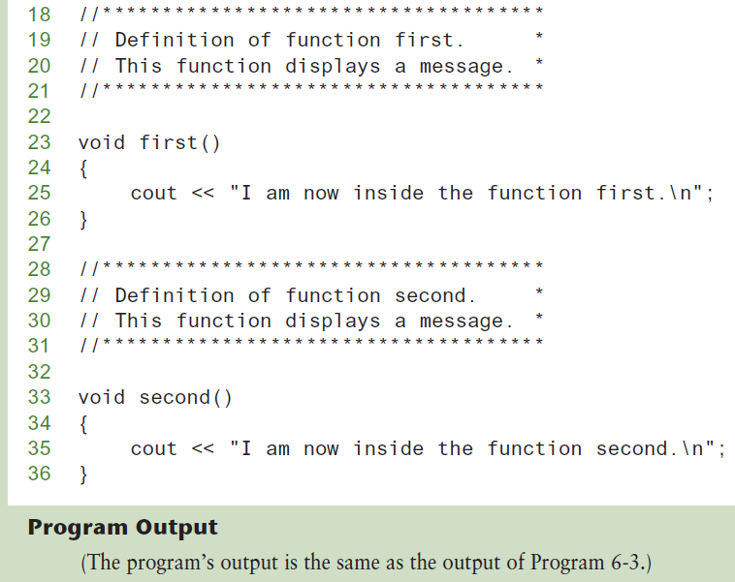
Function Prototypes in Program 6-5 (2 of 2)

Slide 18
Prototype Notes
Place prototypes near top of program
Program must include either prototype or full function definition before any call to the function – compiler error otherwise
When using prototypes, can place function definitions in any order in source file

Slide 19
6.4
Sending Data into a Function

Slide 20
Sending Data into a Function
Can pass values into a function at time of call:
c = pow(a, b);
Values passed to function are arguments
Variables in a function that hold the values passed as arguments are parameters

Slide 21
A Function with a Parameter Variable
void displayValue(int num)
{
cout << "The value is " << num << endl;
}
The integer variable num is a parameter.
It accepts any integer value passed to the function.

Slide 22
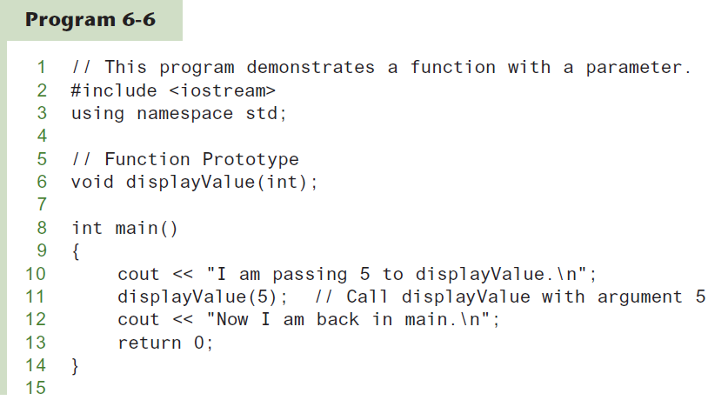
Function with a Parameter

Slide 23
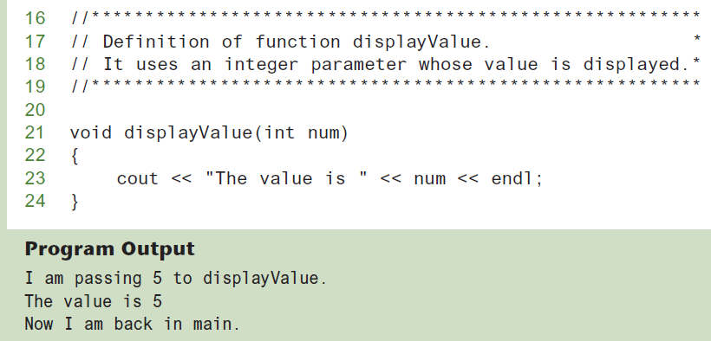
Function with a Parameter in Program 6-6 (1 of 2)

Slide 24
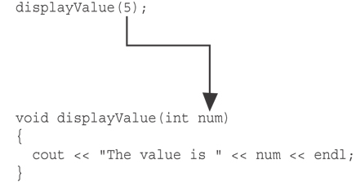
Function with a Parameter in Program 6-6 (2 of 2)
The function call in line 11 passes the value 5
as an argument to the function.

Slide 25
Other Parameter Terminology
A parameter can also be called a formal parameter or a formal argument
An argument can also be called an actual parameter or an actual argument

Slide 26
Parameters, Prototypes, and Function Headers
For each function argument,
the prototype must include the data type of each parameter inside its parentheses
the header must include a declaration for each parameter in its ()
void evenOrOdd(int); //prototype
void evenOrOdd(int num) //header
evenOrOdd(val); //call

Slide 27
Function Call Notes
Value of argument is copied into parameter when the function is called
A parameter’s scope is the function which uses it
Function can have multiple parameters
There must be a data type listed in the prototype () and an argument declaration in the function header () for each parameter
Arguments will be promoted/demoted as necessary to match parameters

Slide 28
Passing Multiple Arguments
When calling a function and passing multiple arguments:
the number of arguments in the call must match the prototype and definition
the first argument will be used to initialize the first parameter, the second argument to initialize the second parameter, etc.

Slide 29
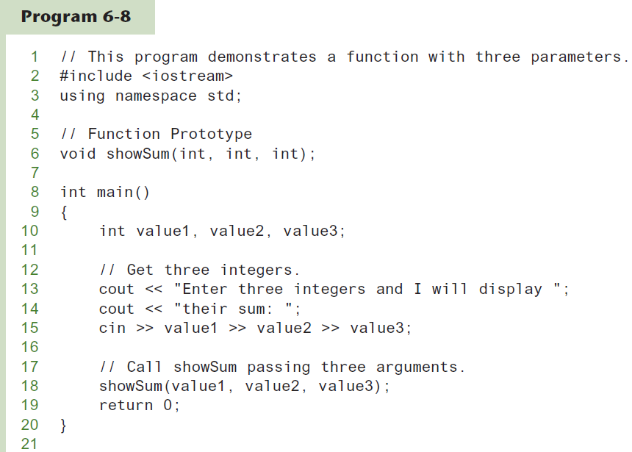
Passing Multiple Arguments in Program 6-8 (1 of 3)

Slide 30
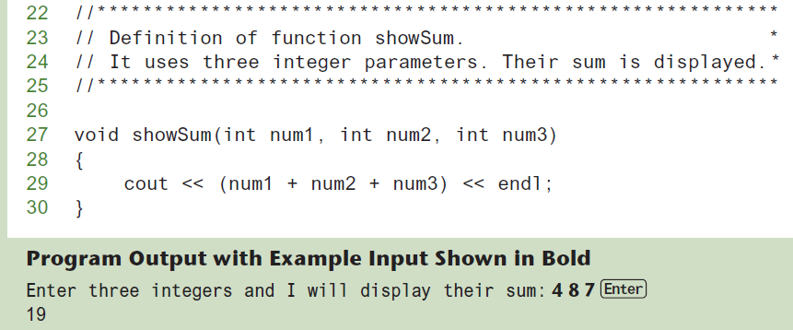
Passing Multiple Arguments in Program 6-8 (2 of 3)

Slide 31
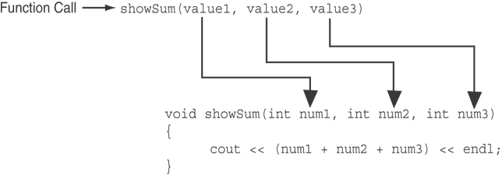
Passing Multiple Arguments in Program 6-8 (3 of 3)
The function call in line 18 passes value1, value2, and value3 as a arguments to the function.

Slide 32
6.5
Passing Data by Value

Slide 33
Passing Data by Value
Pass by value: when an argument is passed to a function, its value is copied into the parameter.
Changes to the parameter in the function do not affect the value of the argument

Slide 34
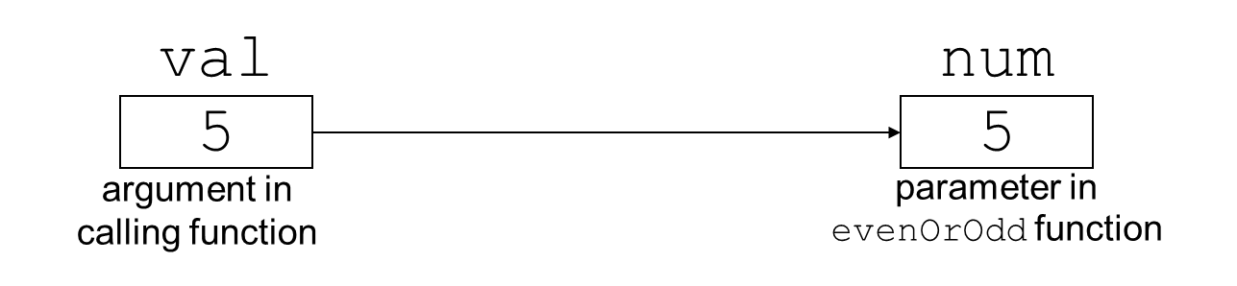
Passing Information to Parameters by Value
Example: int val=5;
evenOrOdd(val);
evenOrOdd can change variable num, but it will have no effect on variable val

Slide 35
6.6
Using Functions in Menu-Driven Programs

Slide 36
Using Functions in Menu-Driven Programs
Functions can be used
to implement user choices from menu
to implement general-purpose tasks:
Higher-level functions can call general-purpose functions, minimizing the total number of functions and speeding program development time
See Program 6-10 in the book

Slide 37
6.7
The return Statement

Slide 38
The return Statement
Used to end execution of a function
Can be placed anywhere in a function
Statements that follow the return statement will not be executed
Can be used to prevent abnormal termination of program
In a void function without a return statement, the function ends at its last }

Slide 39
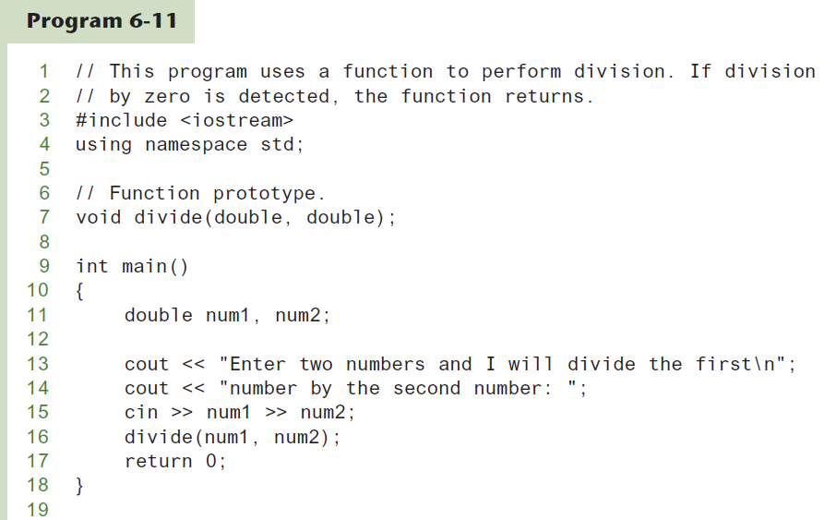
Performing Division in Program 6-11 (1 of 2)

Slide 40
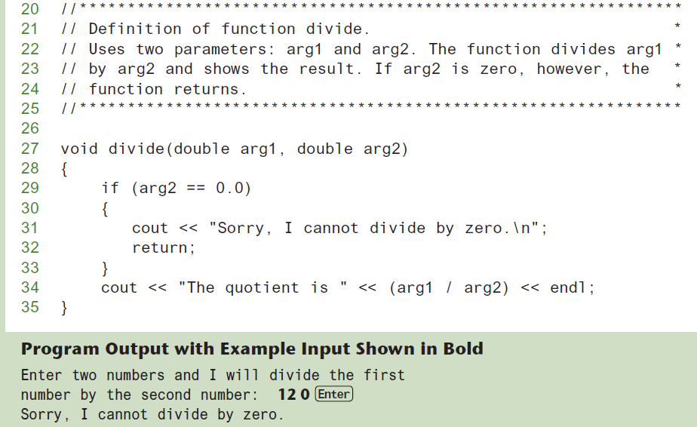
Performing Division in Program 6-11 (2 of 2)

Slide 41
6.8
Returning a Value From a Function

Slide 42
Returning a Value From a Function (1 of 2)
A function can return a value back to the statement that called the function.
You've already seen the pow function, which returns a value:
double x; x = pow(2.0, 10.0);

Slide 43
Returning a Value From a Function (2 of 2)
In a value-returning function, the return statement can be used to return a value from function to the point of call. Example:
int sum(int num1, int num2) { double result; result = num1 + num2; return result; }

Slide 44
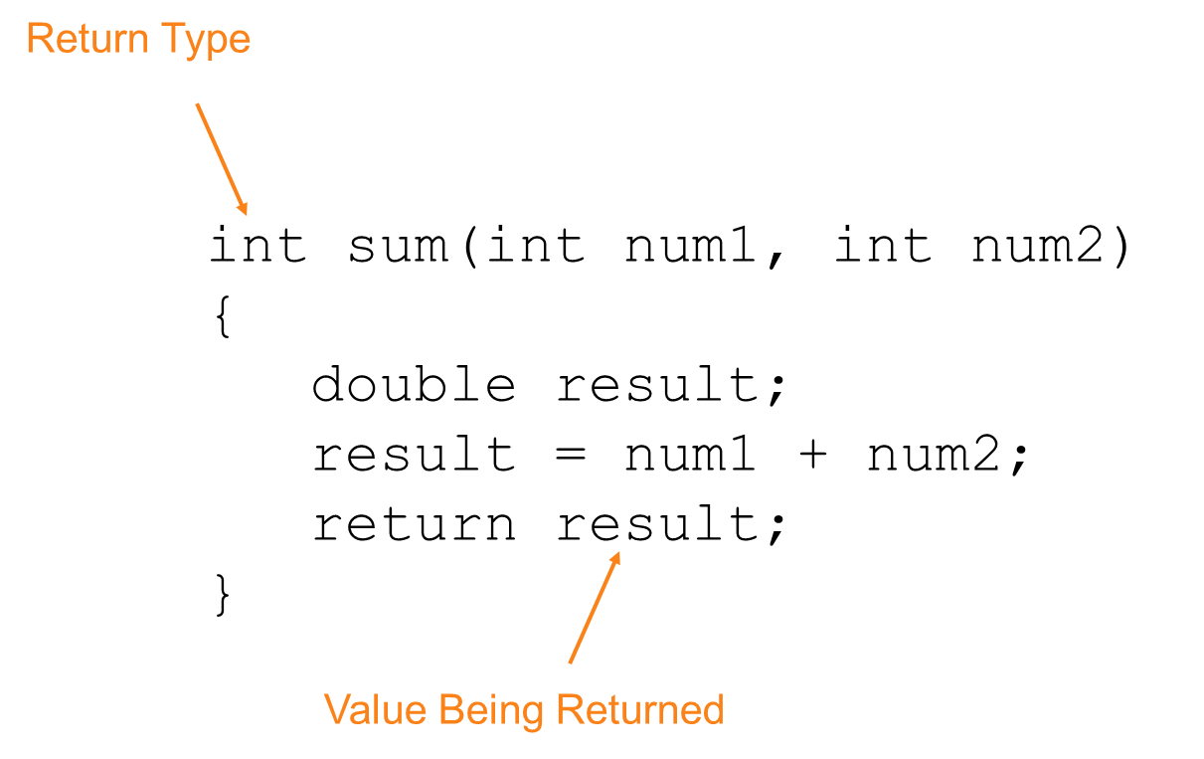
A Value-Returning Function (1 of 2)

Slide 45
A Value-Returning Function (2 of 2)
int sum(int num1, int num2) {
return num1 + num2;
}
Functions can return the values of expressions, such as num1 + num2

Slide 46
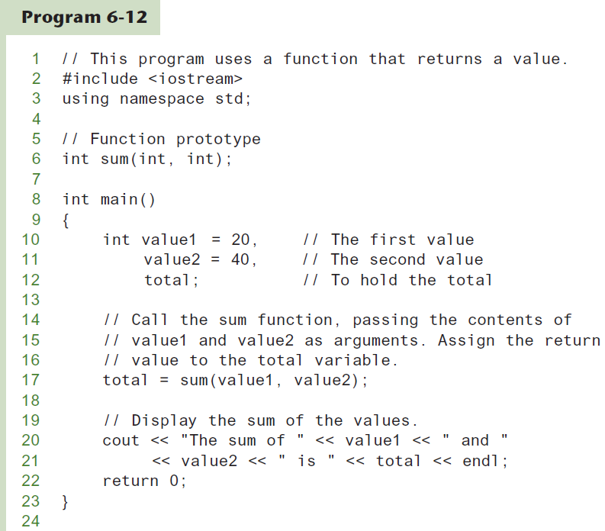
Function Returning a Value in Program 6-12 (1 of 3)

Slide 47
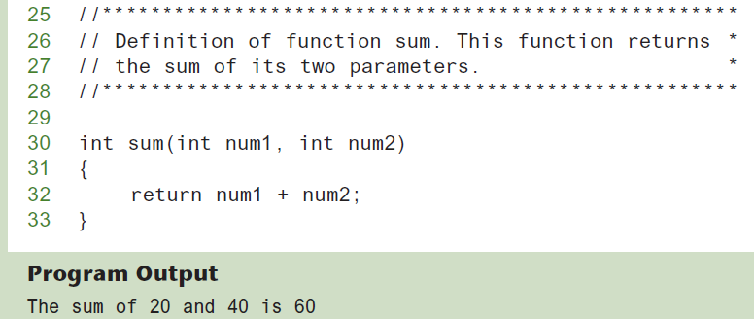
Function Returning a Value in Program 6-12 (2 of 3)

Slide 48
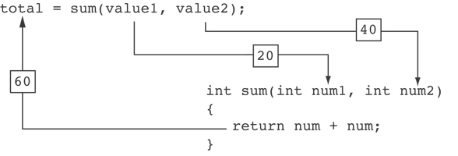
Function Returning a Value in Program 6-12 (3 of 3)
The statement in line 17 calls the sum function, passing value1 and value2 as arguments. The return value is assigned to the total variable.

Slide 49
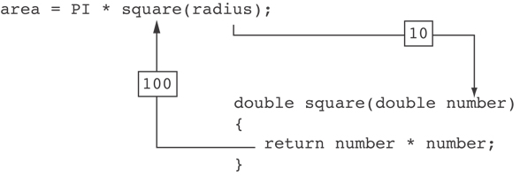
Another Example from Program 6-13

Slide 50
Returning a Value From a Function
The prototype and the definition must indicate the data type of return value (not void)
Calling function should use return value:
assign it to a variable
send it to cout
use it in an expression

Slide 51
6.9
Returning a Boolean Value

Slide 52
Returning a Boolean Value
Function can return true or false
Declare return type in function prototype and heading as bool
Function body must contain return statement(s) that return true or false
Calling function can use return value in a relational expression

Slide 53
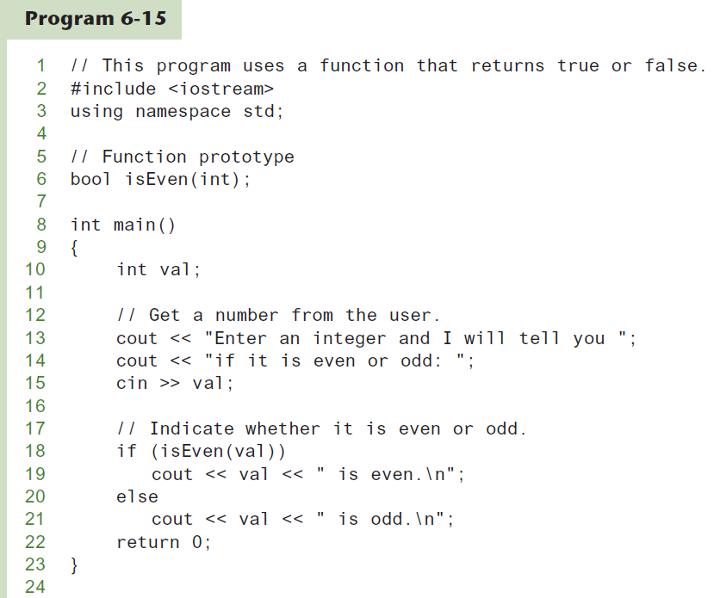
Returning a Boolean Value in Program 6-15 (1 of 2)

Slide 54
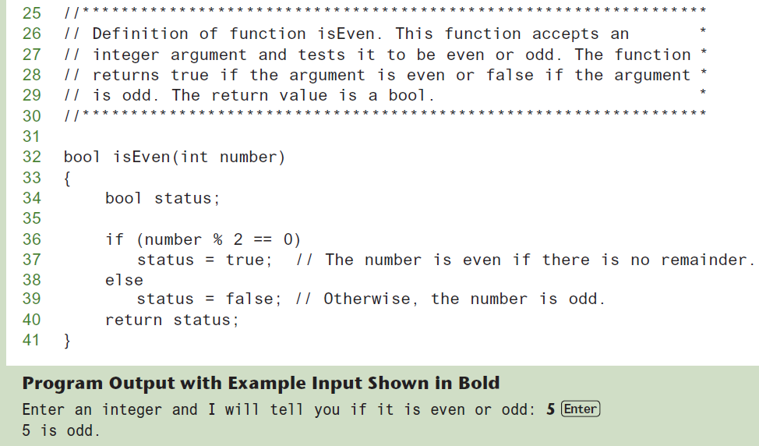
Returning a Boolean Value in Program 6-15 (2 of 2)

Slide 55
6.10
Local and Global Variables

Slide 56
Local and Global Variables
Variables defined inside a function are local to that function. They are hidden from the statements in other functions, which normally cannot access them.
Because the variables defined in a function are hidden, other functions may have separate, distinct variables with the same name.

Slide 57
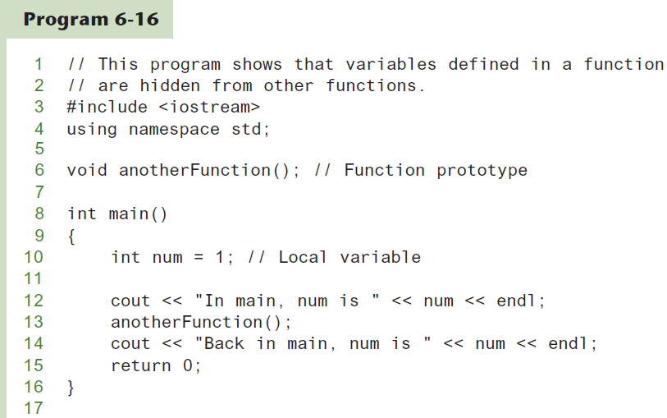
Local Variables in Program 6-16 (1 of 3)

Slide 58
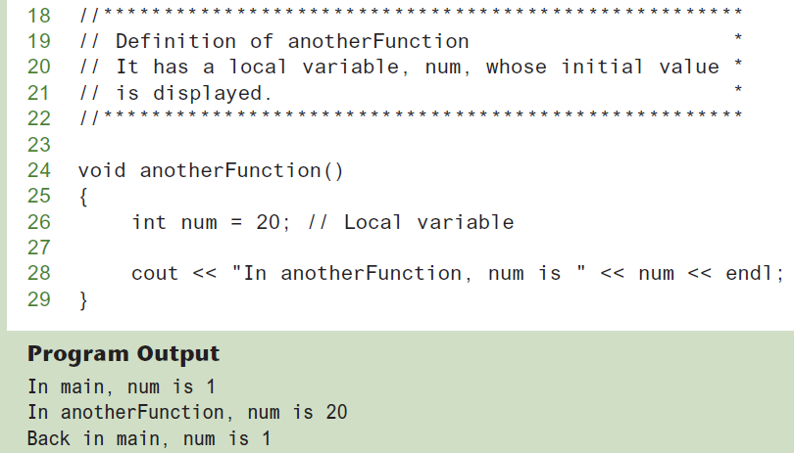
Local Variables in Program 6-16 (2 of 3)

Slide 59
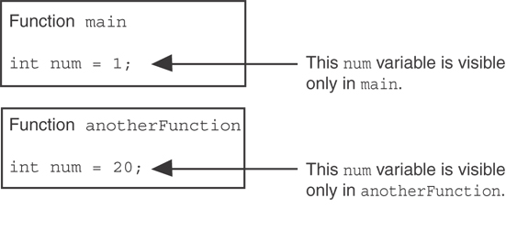
Local Variables in Program 6-16 (3 of 3)
When the program is executing in main, the num variable defined in main is visible. When anotherFunction is called, however, only variables defined inside it are visible, so the num variable in main is hidden.

Slide 60
Local Variable Lifetime
A function’s local variables exist only while the function is executing. This is known as the lifetime of a local variable.
When the function begins, its local variables and its parameter variables are created in memory, and when the function ends, the local variables and parameter variables are destroyed.
This means that any value stored in a local variable is lost between calls to the function in which the variable is declared.

Slide 61
Global Variables and Global Constants (1 of 2)
A global variable is any variable defined outside all the functions in a program.
The scope of a global variable is the portion of the program from the variable definition to the end.
This means that a global variable can be accessed by all functions that are defined after the global variable is defined.

Slide 62
Global Variables and Global Constants (2 of 2)
You should avoid using global variables because they make programs difficult to debug.
Any global that you create should be global constants.

Slide 63
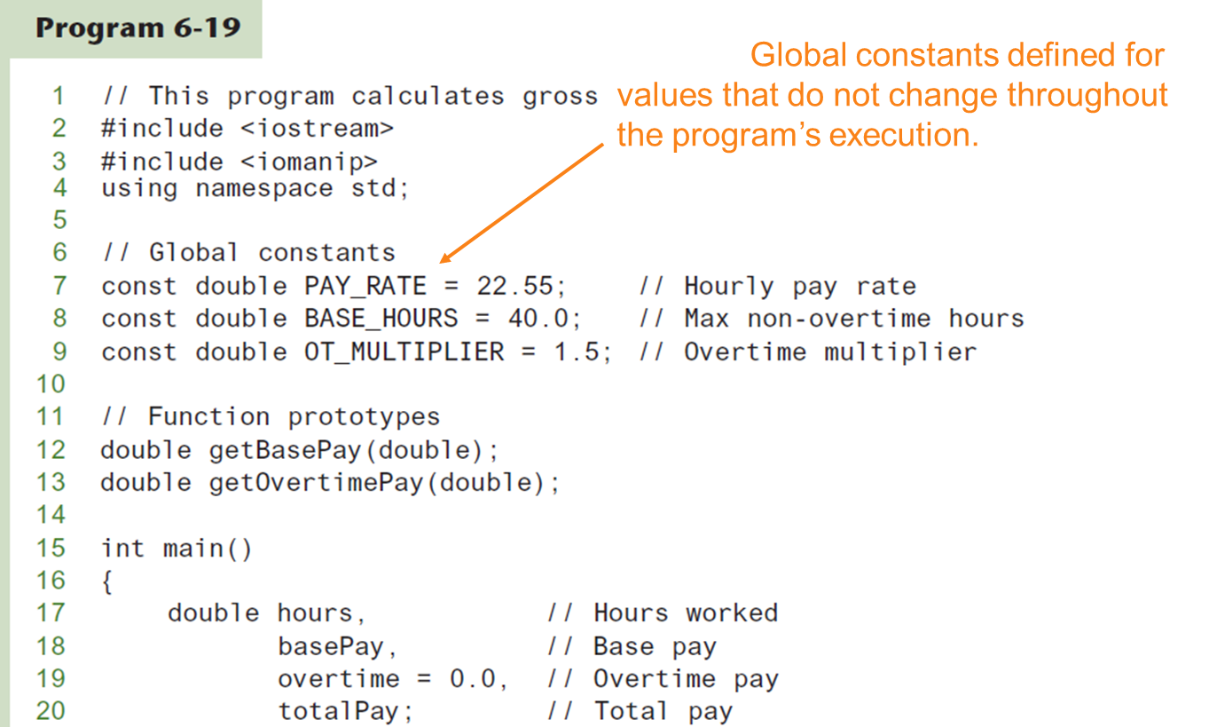
Global Constants in Program 6-19 (1 of 2)

Slide 64
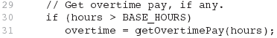
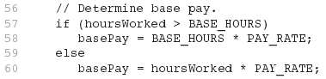
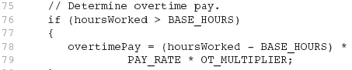
Global Constants in Program 6-19 (2 of 2)
The constants are then used for those values throughout the program.

Slide 65
Initializing Local and Global Variables
Local variables are not automatically initialized. They must be initialized by programmer.
Global variables (not constants) are automatically initialized to 0 (numeric) or NULL (character) when the variable is defined.

Slide 66
6.11
Static Local Variables

Slide 67
Static Local Variables
Local variables only exist while the function is executing. When the function terminates, the contents of local variables are lost.
static local variables retain their contents between function calls.
static local variables are defined and initialized only the first time the function is executed. 0 is the default initialization value.

Slide 68
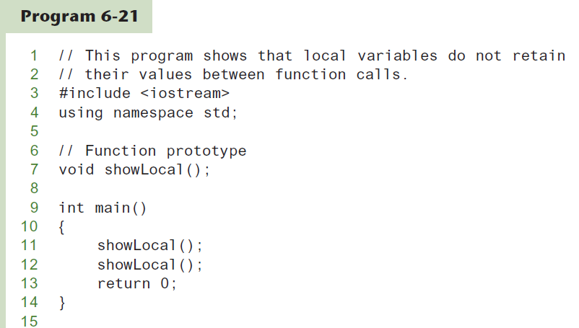
Local Variables Do Not Retain Values Between Function calls in Program 6-21 (1 of 2)

Slide 69
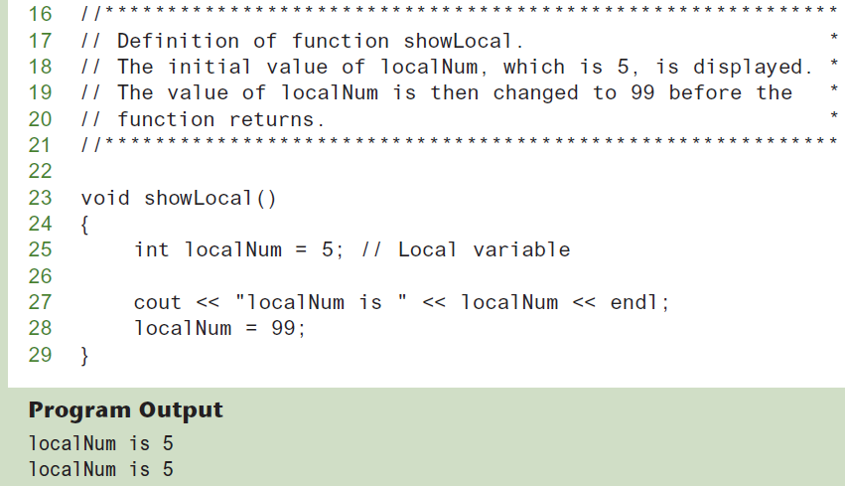
Local Variables Do Not Retain Values Between Function calls in Program 6-21 (2 of 2)
In this program, each time showLocal is called, the localNum variable is re-created and initialized with the value 5.

Slide 70
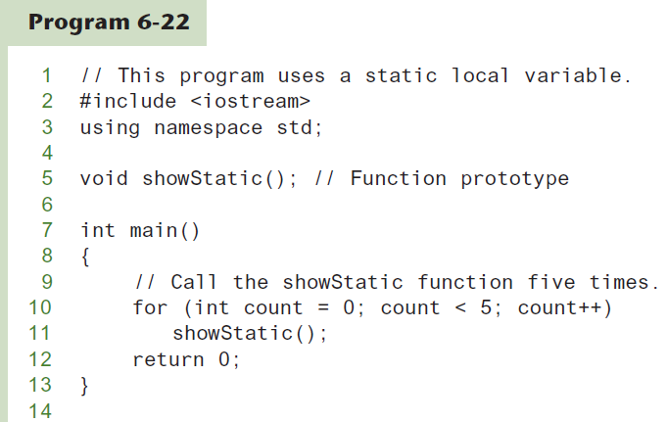
A Different Approach, Using a Static Variable in Program 6-22 (1 of 2)

Slide 71
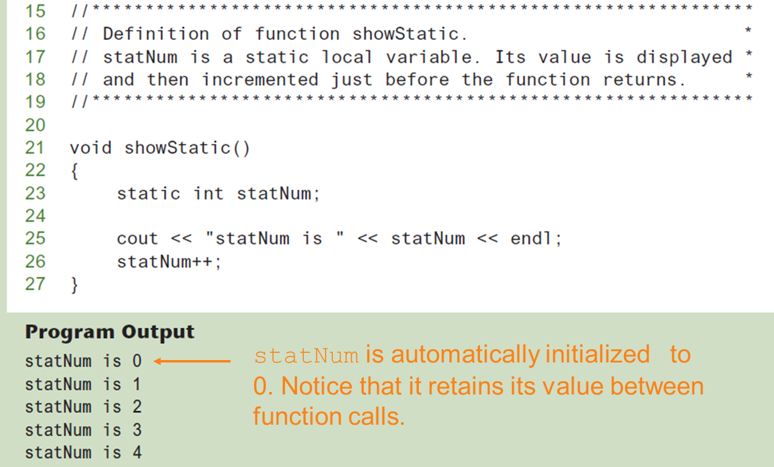
A Different Approach, Using a Static Variable in Program 6-22 (2 of 2)

Slide 72
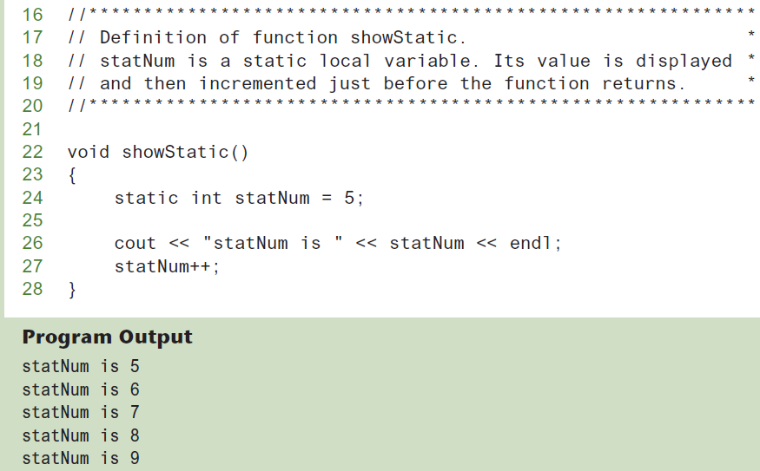
If you do initialize a local static variable, the initialization only happens once. See Program 6-23.

Slide 73
6.12
Default Arguments

Slide 74
Default Arguments (1 of 2)
A Default argument is an argument that is passed automatically to a parameter if the argument is missing on the function call.
Must be a constant declared in prototype:
void evenOrOdd(int = 0);
Can be declared in header if no prototype
Multi-parameter functions may have default arguments for some or all of them:
int getSum(int, int=0, int=0);

Slide 75
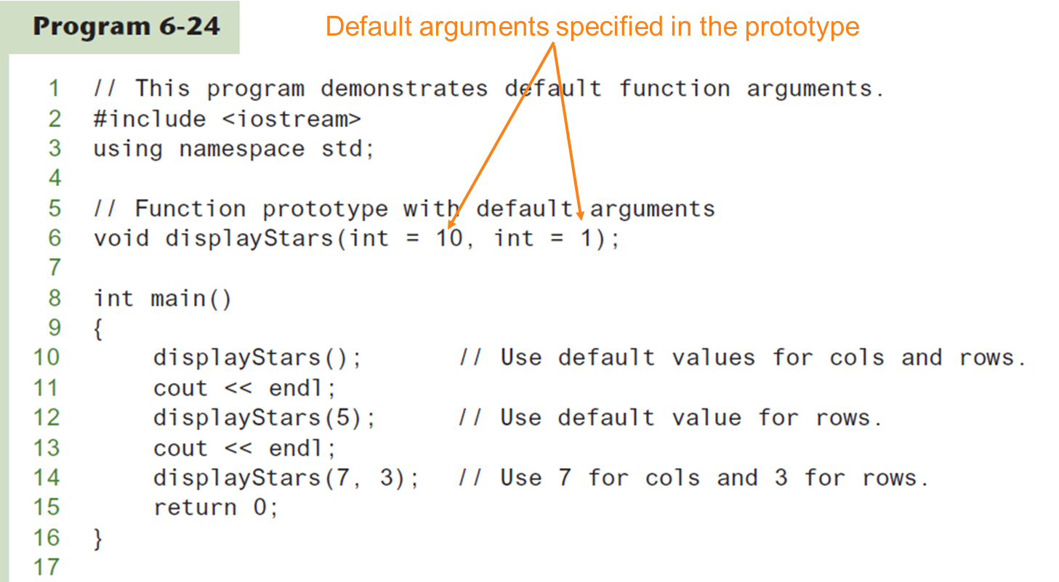
Default Arguments in Program 6-24 (1 of 2)

Slide 76
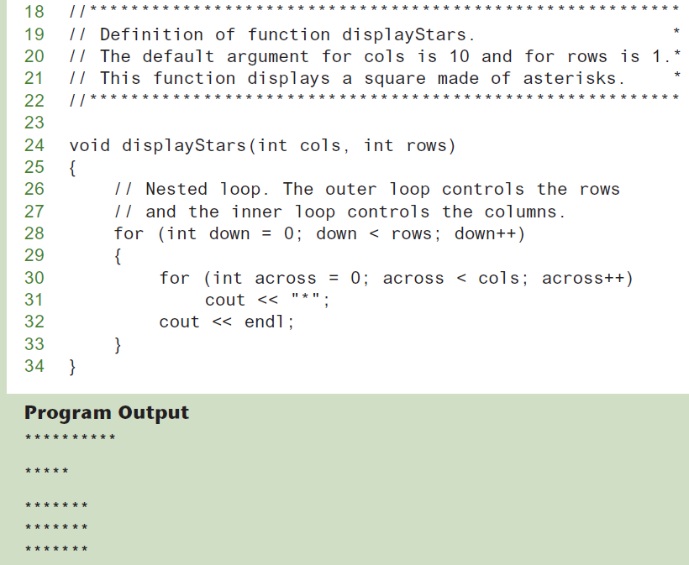
Default Arguments in Program 6-24 (2 of 2)

Slide 77
Default Arguments (2 of 2)
If not all parameters to a function have default values, the defaultless ones are declared first in the parameter list:
int getSum(int, int=0, int=0);// OK
int getSum(int, int=0, int); // NO
When an argument is omitted from a function call, all arguments after it must also be omitted:
sum = getSum(num1, num2); // OK
sum = getSum(num1, , num3); // NO

Slide 78
6.13
Using Reference Variables as Parameters

Slide 79
Using Reference Variables as Parameters
A mechanism that allows a function to work with the original argument from the function call, not a copy of the argument
Allows the function to modify values stored in the calling environment
Provides a way for the function to ‘return’ more than one value

Slide 80
Passing by Reference
A reference variable is an alias for another variable
Defined with an ampersand (&)
void getDimensions(int&, int&);
Changes to a reference variable are made to the variable it refers to
Use reference variables to implement passing parameters by reference

Slide 81
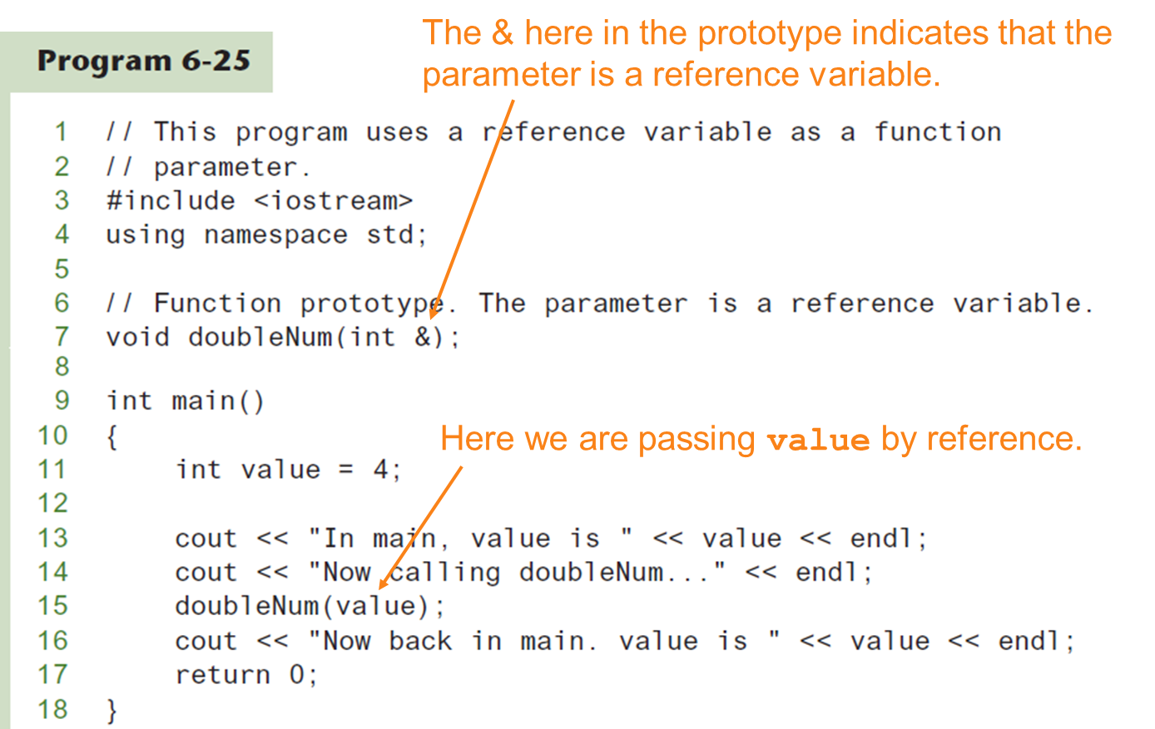
Passing a Variable By Reference

Slide 82
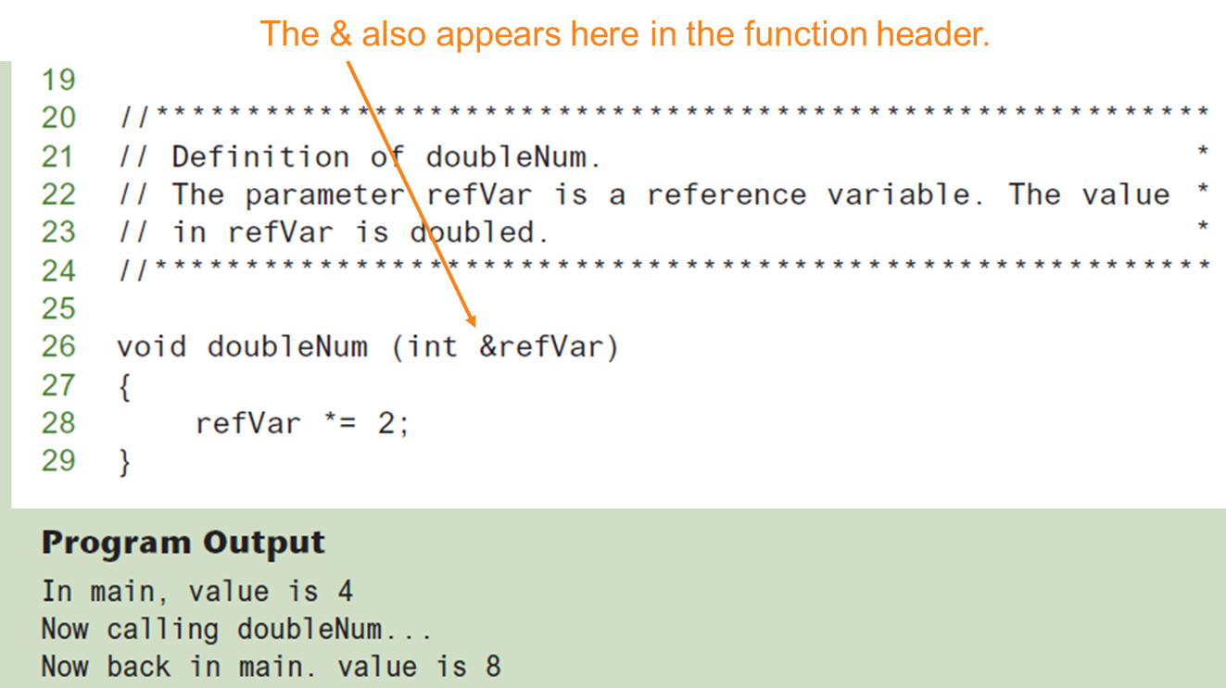
Passing a Variable By Reference in Program 6-25

Slide 83
Reference Variable Notes
Each reference parameter must contain &
Space between type and & is unimportant
Must use & in both prototype and header
Argument passed to reference parameter must be a variable – cannot be an expression or constant
Use when appropriate – don’t use when argument should not be changed by function, or if function needs to return only 1 value

Slide 84
6.14
Overloading Functions

Slide 85
Overloading Functions
Overloaded functions have the same name but different parameter lists
Can be used to create functions that perform the same task but take different parameter types or different number of parameters
Compiler will determine which version of function to call by argument and parameter lists

Slide 86
Function Overloading Examples
Using these overloaded functions,
void getDimensions(int); // 1
void getDimensions(int, int); // 2
void getDimensions(int, double); // 3
void getDimensions(double, double);// 4
the compiler will use them as follows:
int length, width;
double base, height;
getDimensions(length); // 1
getDimensions(length, width); // 2
getDimensions(length, height); // 3
getDimensions(height, base); // 4

Slide 87
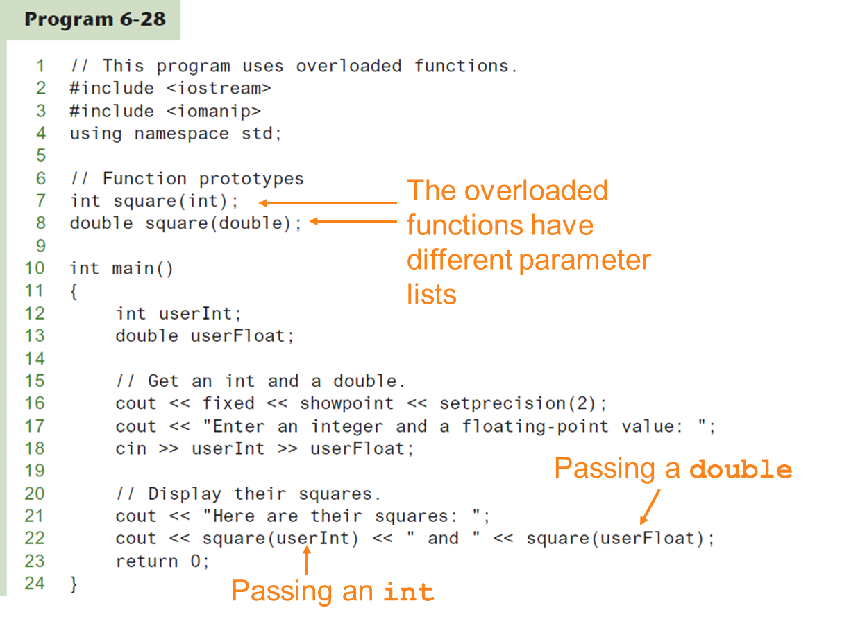
Function Overloading (1 of 2)

Slide 88
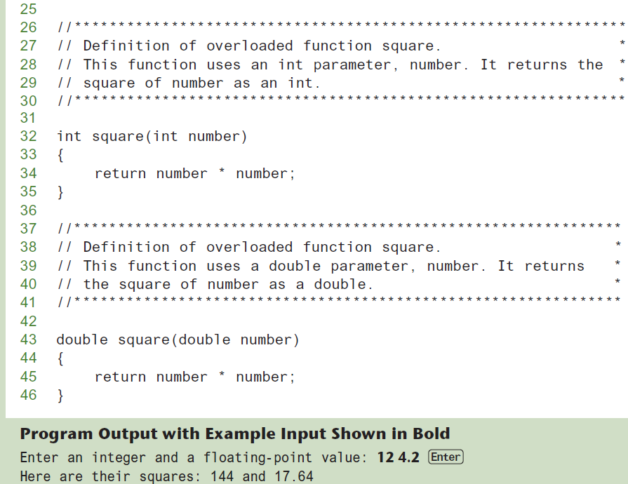
Function Overloading (2 of 2)

Slide 89
6.15
The exit() Function

Slide 90
The exit() Function (1 of 2)
Terminates the execution of a program
Can be called from any function
Can pass an int value to operating system to indicate status of program termination
Usually used for abnormal termination of program
Requires cstdlib header file

Slide 91
The exit() Function (2 of 2)
Example:
exit(0);
The cstdlib header defines two constants that are commonly passed, to indicate success or failure:
exit(EXIT_SUCCESS); exit(EXIT_FAILURE);

Slide 92
6.16
Stubs and Drivers

Slide 93
Stubs and Drivers
Useful for testing and debugging program and function logic and design
Stub: A dummy function used in place of an actual function
Usually displays a message indicating it was called. May also display parameters
Driver: A function that tests another function by calling it
Various arguments are passed and return values are tested

